Slide 1

Competitive Market Equilibrium
2.3
Copyright Chandler Bell

Slide 2
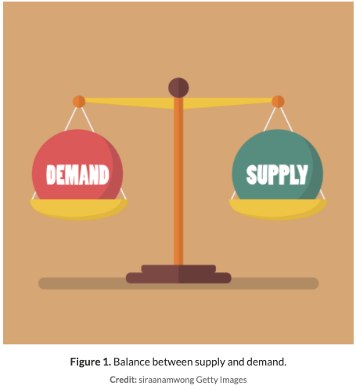
Definition
Equilibrium
  Equilibrium is a state of balance, where two opposing forces are equally matched.
  The market equilibrium occurs at the point where the supply curve of a good or service crosses the demand curve.
  The equilibrium price, also called the market-clearing price, is the price at which the quantity demanded of a good is equal to the quantity supplied
Copyright Chandler Bell

Slide 3
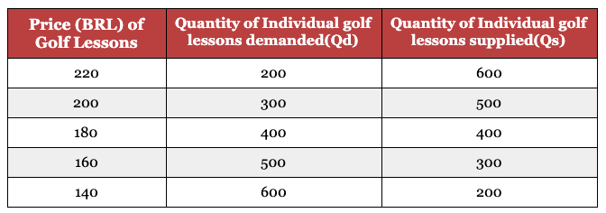


Equilibrium
What is the Equilibrium Price and Quantity in this example of golf lessons in Brazil?
Copyright Chandler Bell

Slide 4
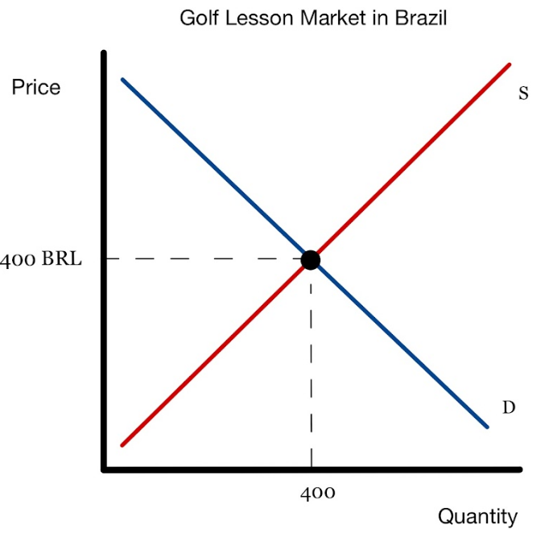
Equilibrium
Copyright Chandler Bell

Slide 5

Attention
Now, from this point on, you should only be drawing complete Supply and Demand graphs with both curves present.
Copyright Chandler Bell

Slide 6


Disequilibrium
  As markets move with Supply and Demand shifting, the market typically finds itself in disequilibrium where Qd does not equal Qs.
  These issues are theoretically seen as temporary, and the market should adjust to equilibrium.
Copyright Chandler Bell

Slide 7
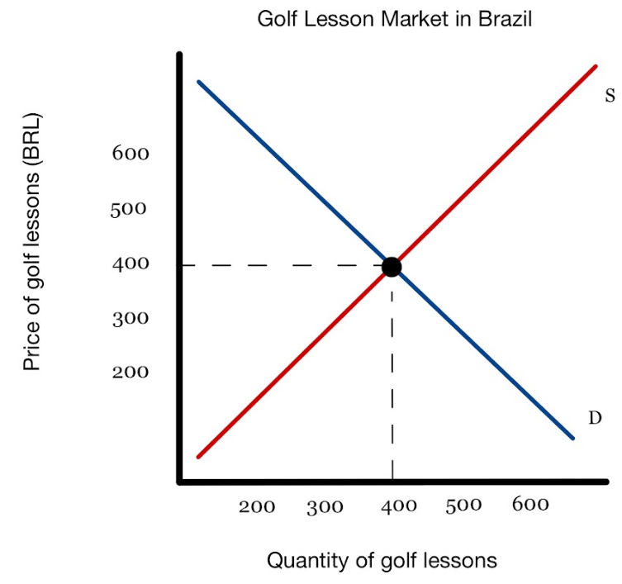
Excess Supply (Surplus)
  Quantity Supplied > Quantity Demanded
What will happen if the price of golfing lessons rises to BRL 500? Use specific numbers
Copyright Chandler Bell

Slide 8
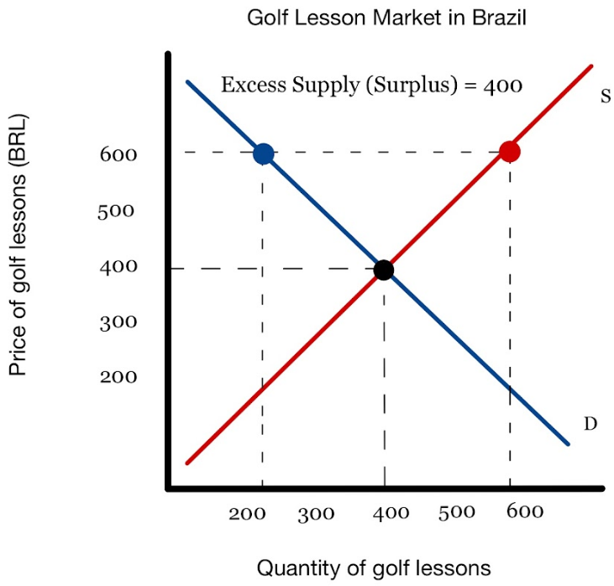
Excess Supply (Surplus)
Copyright Chandler Bell

Slide 9
Excess Supply (Surplus)
What will happen if the price of golfing lessons rises further to BRL 600? Use specific numbers
Copyright Chandler Bell

Slide 10
Excess Supply (Surplus)
Copyright Chandler Bell

Slide 11
Excess Demand (Shortage)
  Quantity Demanded > Quantity Supply
What will happen if the price of golfing lessons drops to BRL 300? Use specific numbers
Copyright Chandler Bell

Slide 12
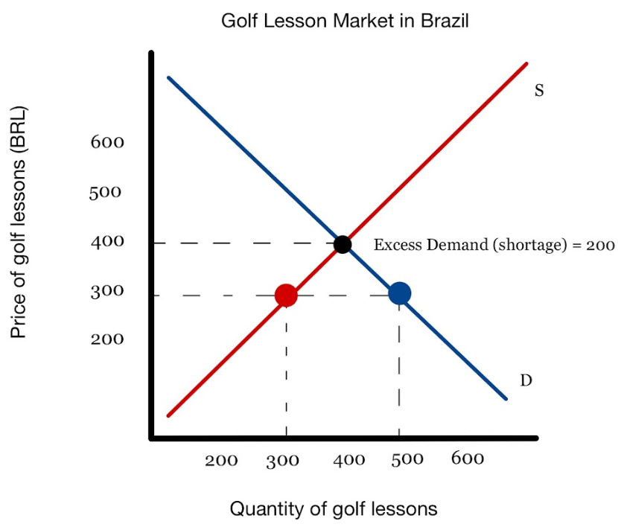
Excess Demand (Shortage)
Copyright Chandler Bell

Slide 13
Excess Demand (Shortage)
  Quantity Demanded > Quantity Supply
What will happen if the price of golfing lessons drops further to BRL 200? Use specific numbers
Copyright Chandler Bell

Slide 14
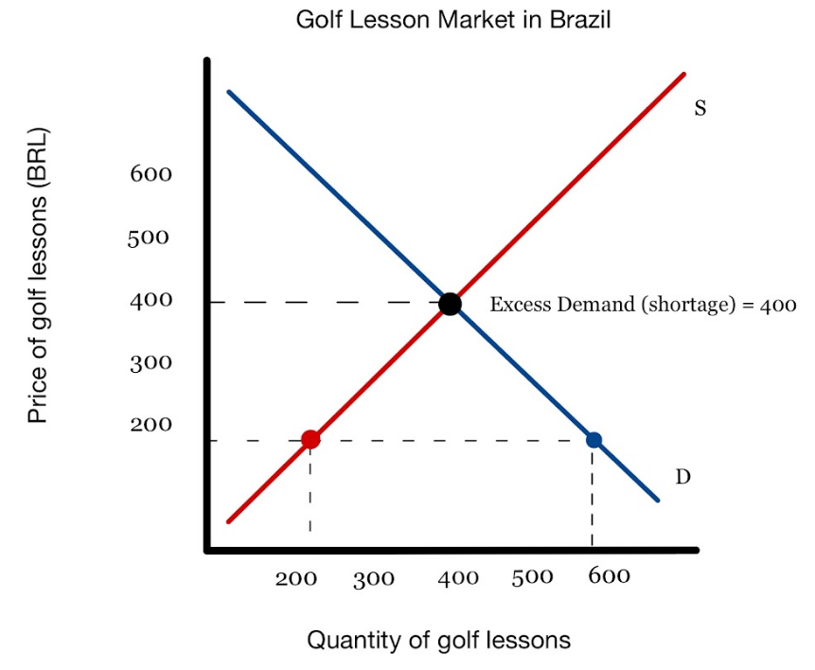
Excess Demand (Shortage)
Copyright Chandler Bell

Slide 15

Video
Copyright Chandler Bell

Slide 16

Practice
Copyright Chandler Bell

Slide 17
Supply & Demand Analysis
Follow Step 1,2, and 3.
  Draw supply and demand. Label Equilibrium Price and Quantity
  Draw the change
    Does it affect Supply or Demand FIRST?
    What is the shifter? Increase or Decrease
  After change
    Label new Equilibrium. What happened to P? What happened to Q?
Analyze Pizza
  New Pizza oven technology makes production more efficient.
  Price of calzones decrease
  Price of Pizza rises from $2 to $4
  Price of wheat doubles
  Human Hair consistently found in pizza slices
  A large conference takes place near our pizza restaurant
Copyright Chandler Bell

Slide 18

Practice
IN 2018, THE KOREAN GOVERNMENT INCREASED SUBSIDIES FOR SOYBEANS AND REDUCED SUBSIDIES FOR WHEAT. USE APPROPRIATE DIAGRAMS TO EXPLAIN THE IMPACT ON THE SOYBEAN AND WHEAT MARKETS OF THESE CHANGES TO SUBSIDIES.
Copyright Chandler Bell

Slide 19
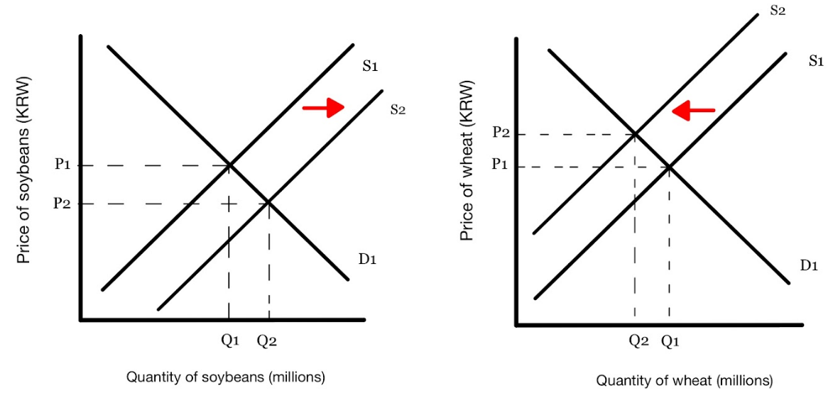
Answer
A subsidy is a government payment to a producer with the aim of increasing supply or lowering prices in the market. An increase in subsidies for Korean soybean farmers should increase the supply of soybeans. A decrease in subsidies for Korean wheat farmers should decrease the supply of wheat. The impact is shown in Figure 5 and Figure 6. The supply of soybeans increases from S1 to S2. The price of soybeans decreases from P1 to P2 and the quantity demanded and supplied of soybeans increases from Q1 to Q2, ceteris paribus. The supply of wheat decreases from S1 to S2. The price of wheat increases from P1 to P2 and the quantity demanded and supplied of wheat decreases from Q1 to Q2, ceteris paribus.
The change in subsidy policy by the Korean government should result in a greater supply of soybeans and a reduced supply of wheat.
Copyright Chandler Bell

Slide 20

Price Mechanisms
  Changes in price, or the price mechanism determine how scarce resources are allocated in an economy.
  As price changes, the free market corrects itself using a system of negative feedback consisting of signals and incentives.
  Signalling function of prices
    Introduces negative feedback into the market system by communicating WHAT consumers and producers should do. The feedback causes stakeholders to respond in a way that brings the market back into equilibrium, stabilising the system.
  The incentive function of prices
    introduces negative feedback into the market system by
providing financial MOTIVATION to consumers and producers
to react in a way that brings the market back into equilibrium,
stabilising the system.
Copyright Chandler Bell

Slide 21


Rationing
  Rationing refers to the controlled distribution of resources. Rationing is necessary at any time when goods and resources are scarce.
  Price is typically the best rationing function
  However, during times of severe scarcity where individuals are WILLING but NOT ABLE to purchase bar necessities due to dramatic shortages, the government may step in. In World War II for example, government rationing of many goods in the UK.
Copyright Chandler Bell

Slide 22

Recap and Review
Copyright Chandler Bell

Slide 23

  Identify the 5 shifters of demand.
  Identify the 6 shifters of supply .
  Define Subsidy.
  Explain why price DOESN’T shift the curve.
  Define Equilibrium.
  Define Shortage.
  Define Surplus.

Slide 24

Practice Question
Copyright Bananaomics

Slide 25
Paper 1 Part A
N18/3/ECONO/HP1/ENG/TZ0/XX
Copyright Bananaomics

Slide 26
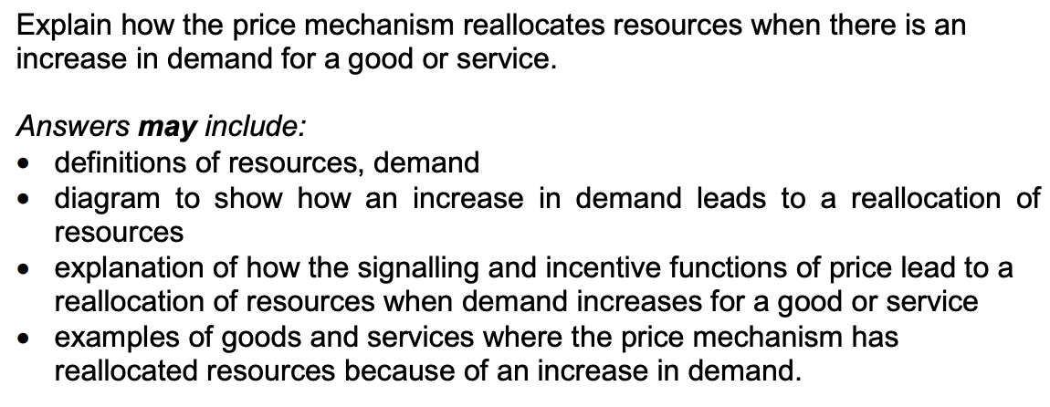
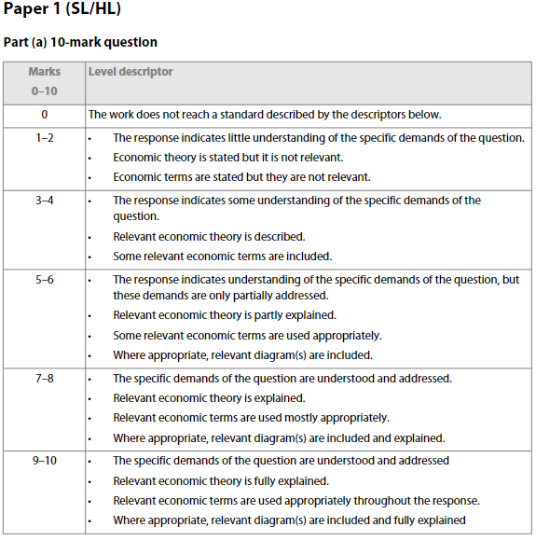
Check Answers
Copyright Bananaomics

Slide 27

Enjoying The Content?
Visit bananaomics.com to purchase package deals with discount prices!
BANANAOMICS

